Slide 1
July Update

Slide 2
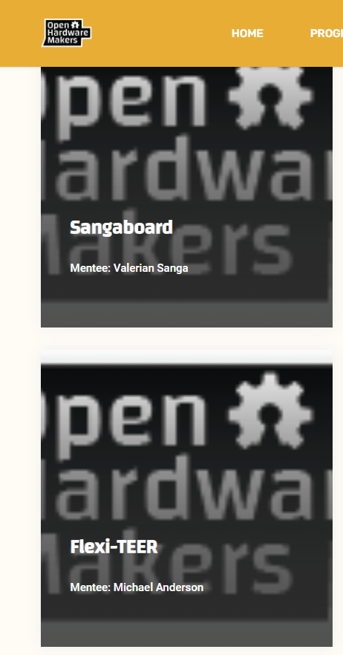

Flexi-TEER Website and Program
Project selected as part of first cohort of mentees for open-source project development with Open Hardware Makers
Project will be listed in upcoming Open Hardware Development guide
Website developed (still in progress) to distribute device and engage potential contributers

Slide 3
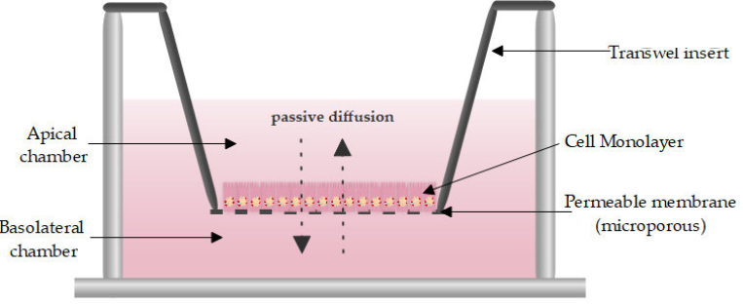
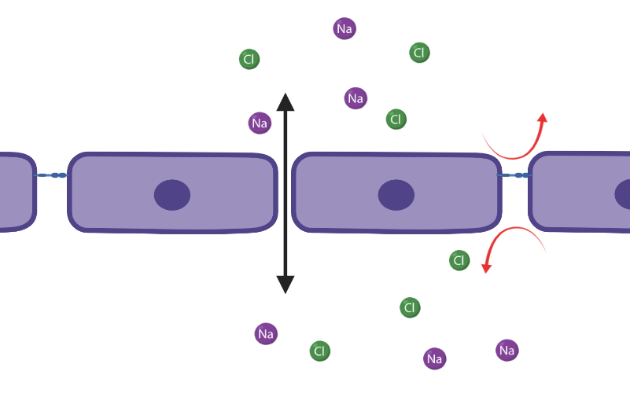
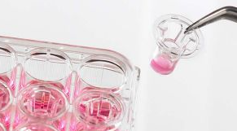
Transwells? Resistance? TEER?

Slide 4
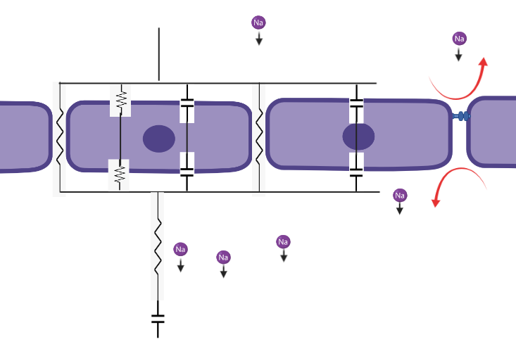
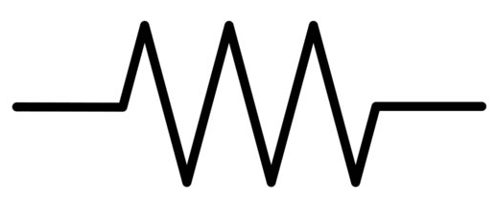
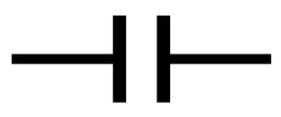
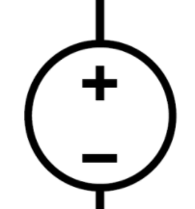
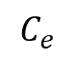
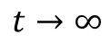
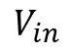
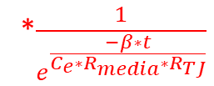
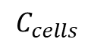
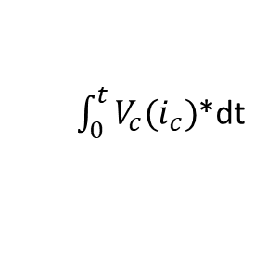
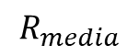
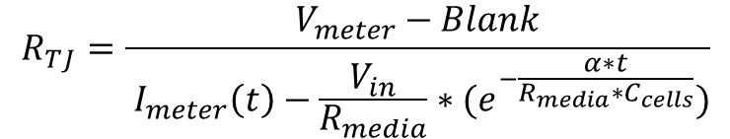
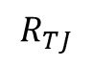
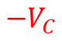
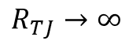
$${−V}_{C}$$
$$R_{TJ}=\frac{V_{meter}−Blank}{ I_{meter}\left(t\right)−{\frac{V_{in}}{R_{media}}∗(e}^{−\frac{α∗t}{R_{media}∗C_{cells}}})}$$
*$\frac{1}{e^{\frac{−β∗t}{C_{e}∗R_{media}∗R_{TJ}}}}$
Lets approximate as:
$$t→∞$$
$$R_{TJ}→∞$$
But why? This is nonsensical. That is a constant value. It cant just go to infinity! The solution lies in the fact that the above solution was never taking the voltage drop over a capacitor into account. It was built assuming all voltage dropped over the media and TJ resistance.
$$R_{media}$$
1
$$C_{e}$$
2
What now though? ☹. This would dictate that we knew with 100% certainty what the time of the voltage reading was from the DC current being applied and the dynamics of the current over time, i.e. solve
$$C_{cells}$$
$$R_{TJ}$$
$$V_{in}$$
$\int_{0}^{t}{V_{c}(i_{c})}$*dt
2
Real hard to solve though ☹
1

Slide 5
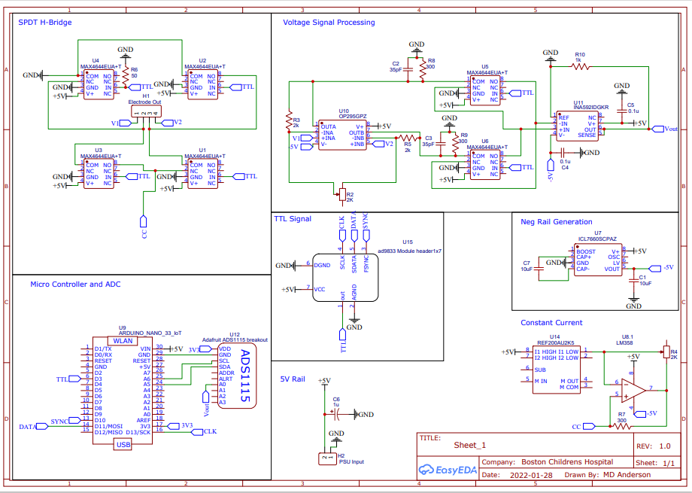
Modular Breakdown of Flexi-TEER + Schematic
Generate DC square Wave with function generator
Generate AC Wave
Read off voltages via instrumentation amp
Send into Differential Amp
Amplify Signal
Send into ADC

Slide 6
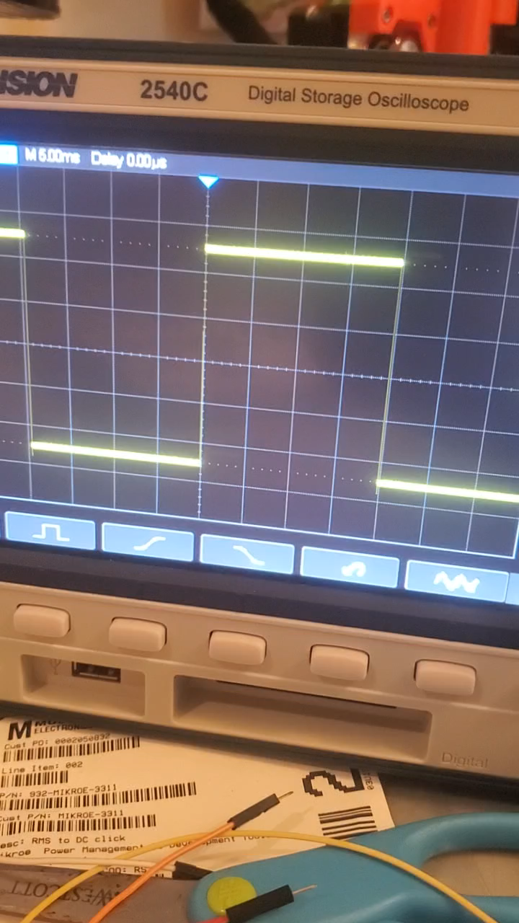
AC conversion issue
Single Pole Dual Throw switches (SPDT) in an H-Bridge config are great at converting 0-(+V) signal into (–V)-(+V) at same freq
Large amounts of noise are introduced when current is squeezed down.

Slide 7
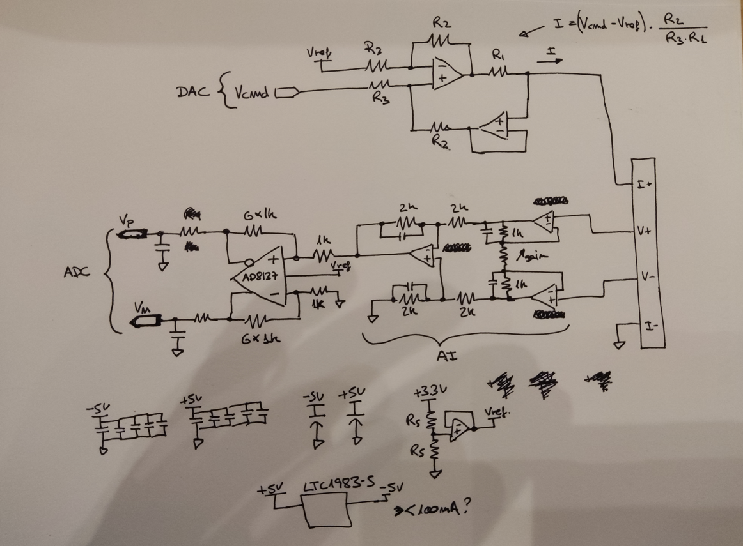
Jose’s Proposed Circuit
AC generation + CC
Amplify and send to ADC
Sample voltage and find difference
Isolate reference voltage
Better Charge Pump

Slide 8
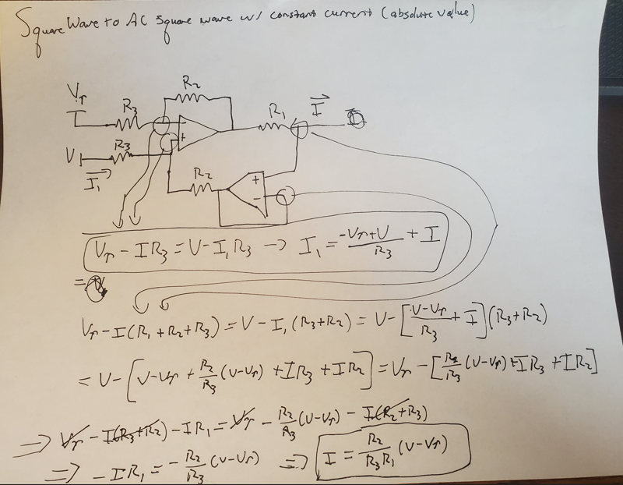
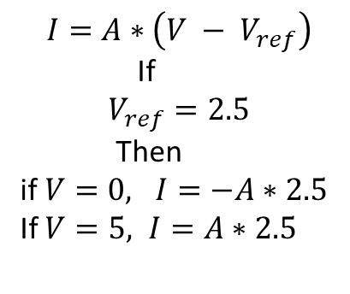
Deriving AC CC unit
$$I=A∗\left(V − V_{ref}\right)$$
If
$$V_{ref}=2.5$$
Then
if $V=0, I=−A∗2.5$
If $V=5, I=A∗2.5$
This only works for square waves! Sine waves will alter current levels and not just change direction

Slide 9
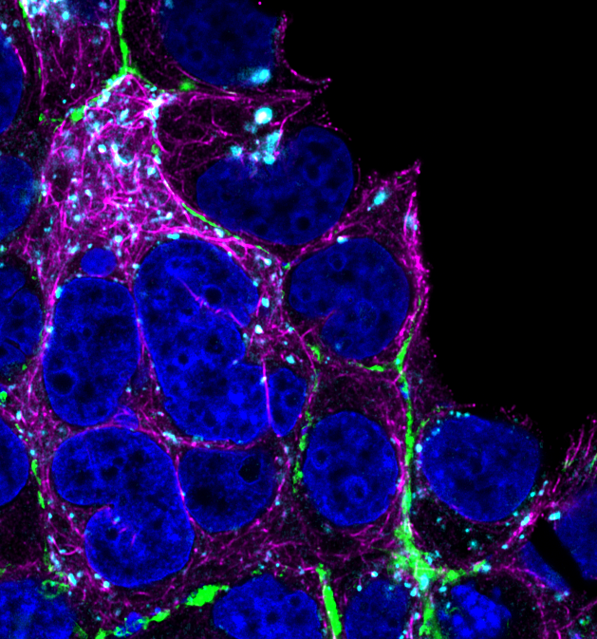
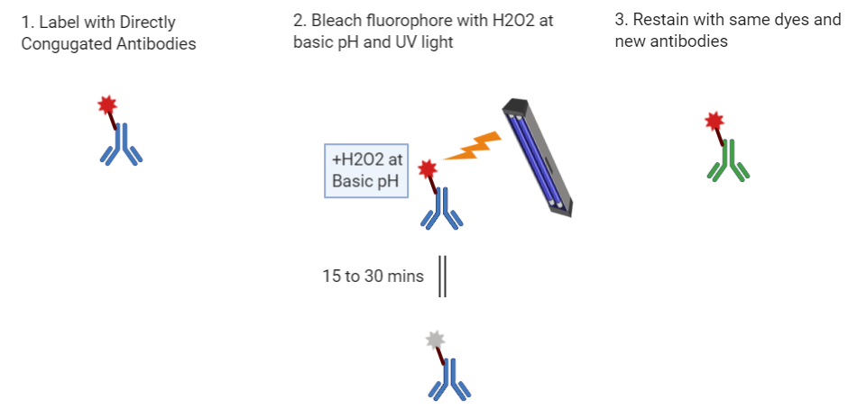
CyCIF Multiplex Technique
Multiplex = getting lots and lots of markers on same tissue or sample
Cyclic technique where instead of removing the old fluorophores, we bleach them to get rid of them.
Cycle 1:
Villin
DAPI
Cycle 2:
LAMP1
Phalloidin
63x
LSM 880

Slide 10
Automation Needs
Auto Focus – Brenner Score
Auto Expose – Threshold on Histogram
Fluidic delivery (large and small scales) – Aquarium and micro stepper peristaltic pump for large and small respectively.
Computational control of microscope and robotic systems – Pycromanager and micromanager
Robotic control system – Arduino and breakout motor drivers
Auto generation of focused surfaces - micromagellan
Auto acquisitions - micromagellan

Slide 11
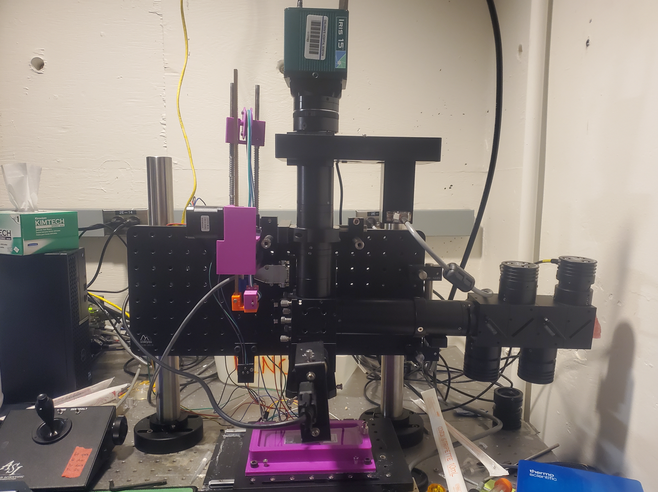

Slide 12
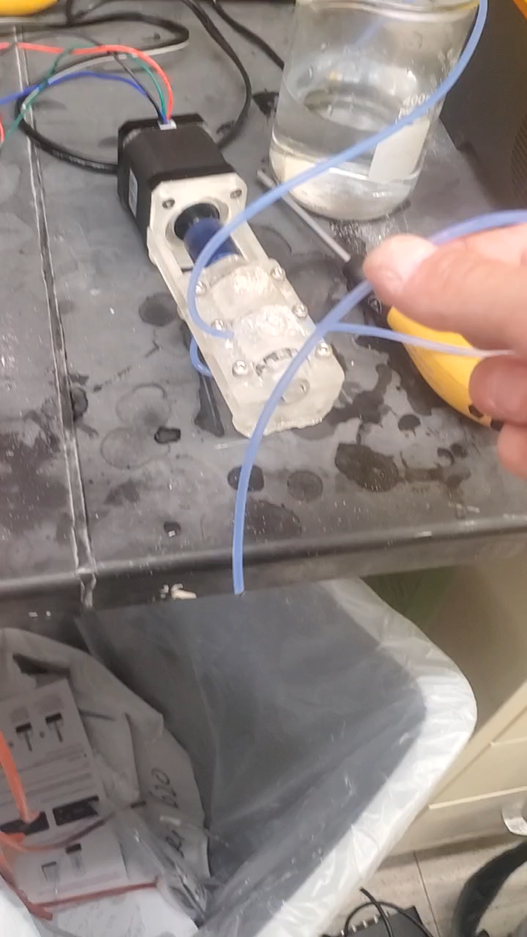
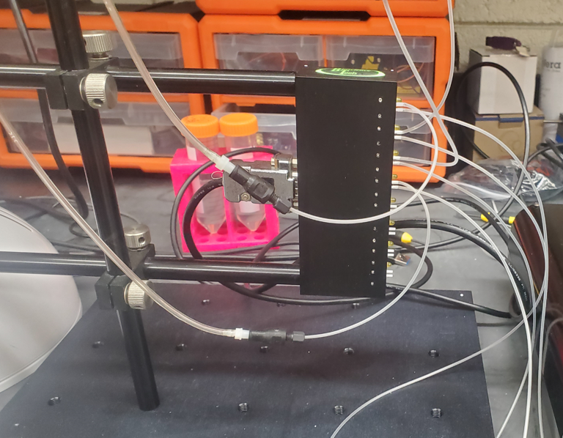
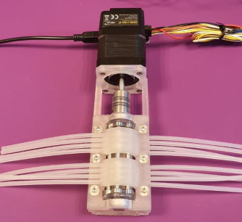
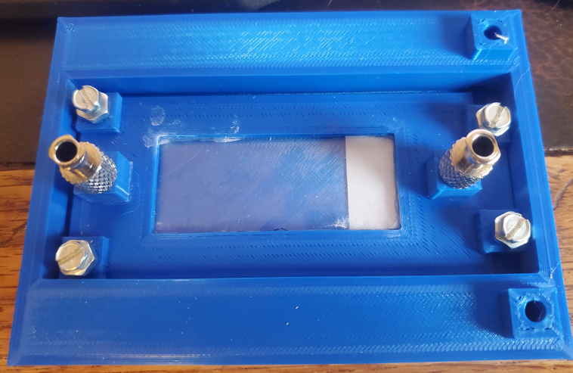
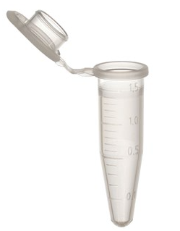
New pump system and the “Invisible” coverslip
Issues with Original System
Large stage movement
150-200uL dead volume
Incomplete washings
Diluted stain solution
Limited room for adding more cycles
Large space taken up
New System
Solution storage
Liquid selector (pinch valve)
Liquid Pump (Peristaltic Pump)
Invisi-Slip Chamber

Slide 13
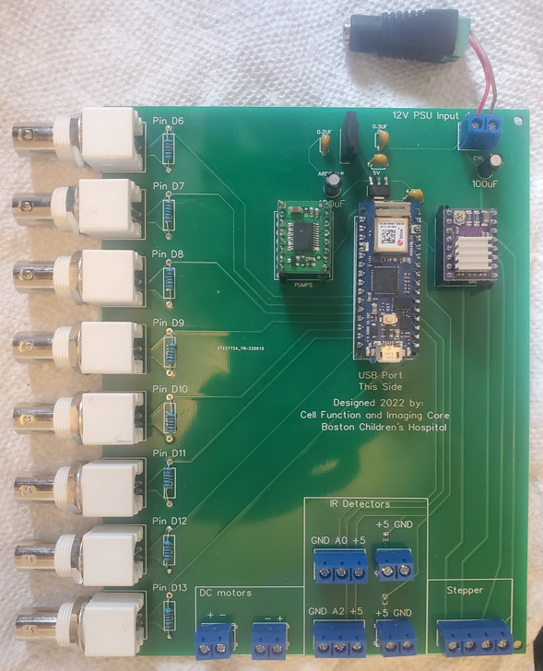
Auto-CIF Control Board V 3.0
On board voltage modulators/PSU
BNC connectors to modulate pinch valve on-off status via TTL waves
Stepper and DC motor drivers
Arduino Microcontroller

Slide 14
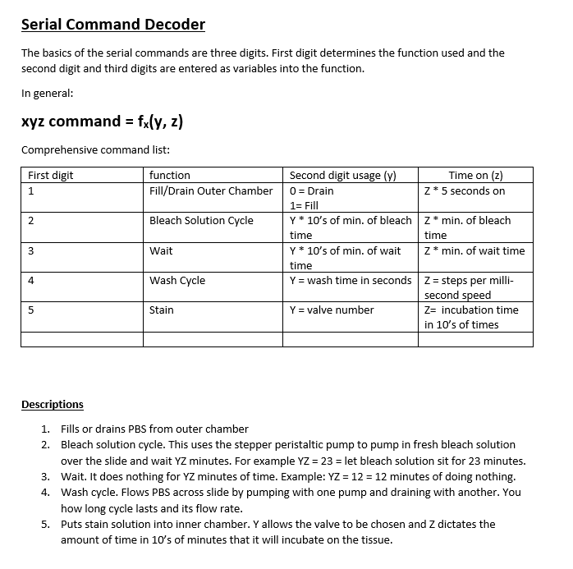
Flexible Serial Command Interface

Slide 15
Invisi-Slip System
Fluid Flow
Objective
Fluid Flow
2500um
WD
FEP Film
1600um
100um Gap
Glass Slide (Tissue side up)
Smallish volume on top of entire slide surface (about 400uL)
No dilution of stain solution
FEP film has RI =1.333, PBS = 1.33, So if PBS is above and below the FEP film, it is effectively invisible
FEP film is a physical barrier, but not an optical barrier

Slide 16
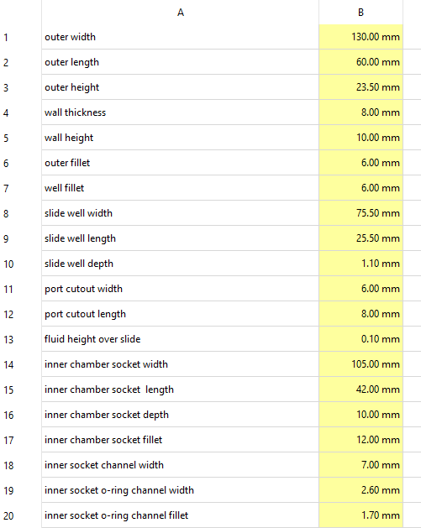
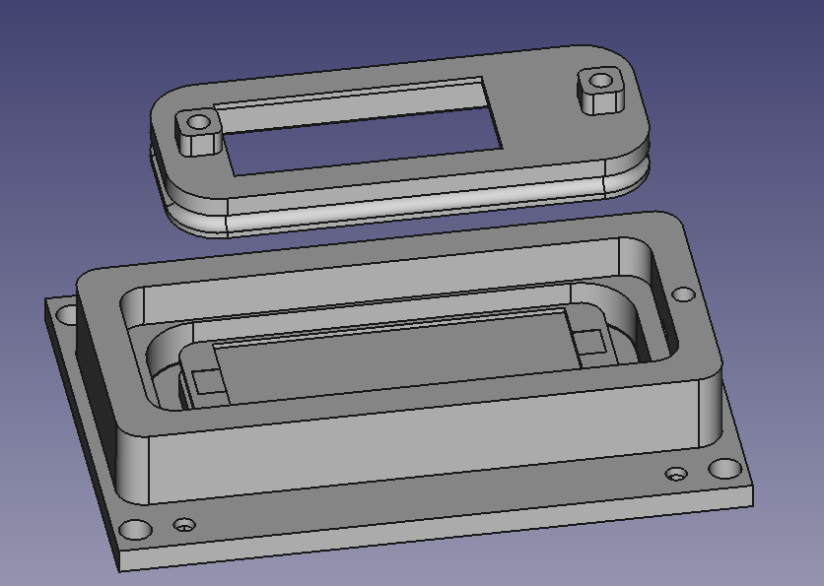
Parametric CAD model
Migrated to the FreeCAD platform from TinkerCAD.
Fully Parametric model to instantly tweak every single feature of the model
More power in features like Fillets and chamfers and symmetries

Slide 17
Current Status Roadmap for Invisi-Slip
Basic CAD Design
Prototype Chamber
Identify new pump system
Design new PCB to interface Arduino with new System
Build Pump System
Finalize Chamber Design and confirm waterproof even in high pH + H2O2 conditions
Tweak Arduino Code to run new system
We are currently here

Slide 18
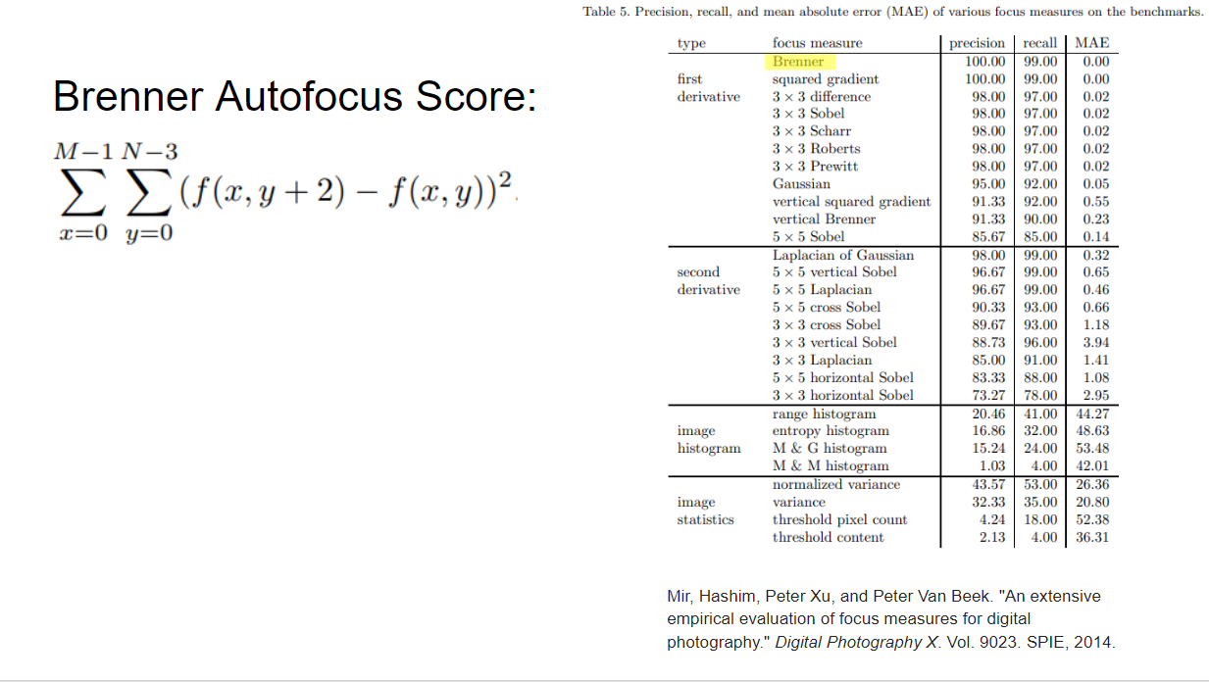

Slide 19
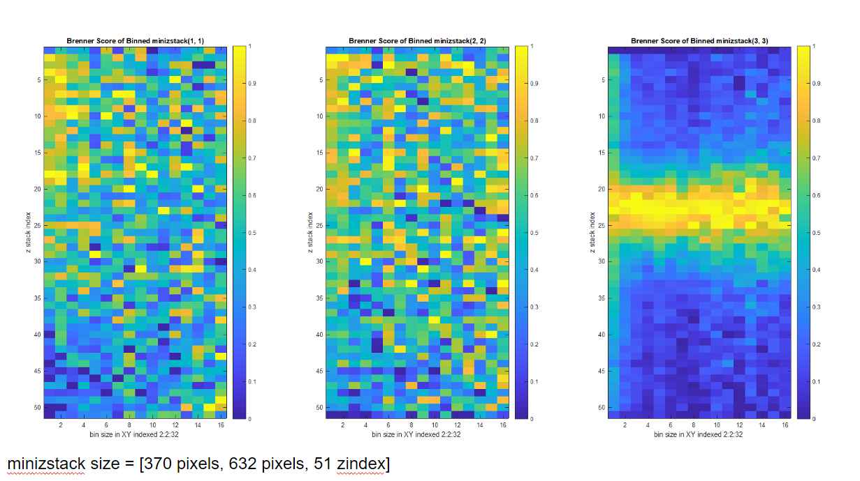

Slide 20
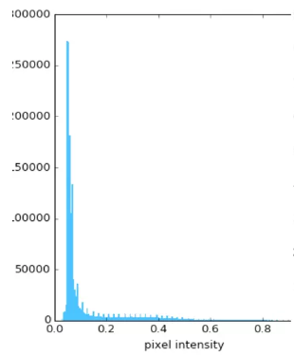
Auto Exposure
Add in sheet of algorithm
Set intensity of the 98% brightest pixel to be at X fraction of dynamic range

Slide 21
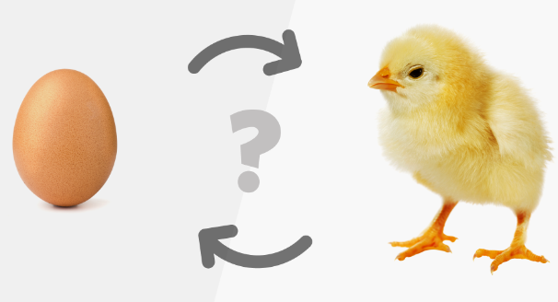
Chicken and Egg problem
Chicken: Brenner based auto focus needs proper exposure to focus correctly
Egg: auto exposure needs to be in focus to determine proper exposure

Slide 22
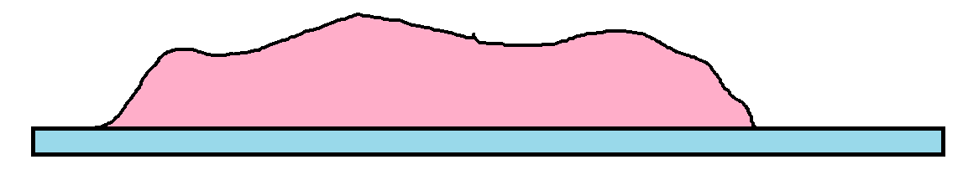
Solution
1. Scan over set Z range

Slide 23
Solution
2. Determine Relative Image Brightness Levels

Slide 24
Solution
3. Auto Expose on Brightest Z slice

Slide 25
Solution
4. Run Auto Focus over same range with determined exposure level

Slide 26
Issues
Software
Wrong Tiling spacing
Glitch in MM where only one surface can be used for Z points
Outdated Drivers
Computer Crashing
Crashing Camera driver
RAM exhaustion in Acq computer
MM multichannel Acq
Hardware
Wrong tubes
Wrong adapter for M32 Objective
Chip Tilt
Reflection
Chamber Leak

Slide 27
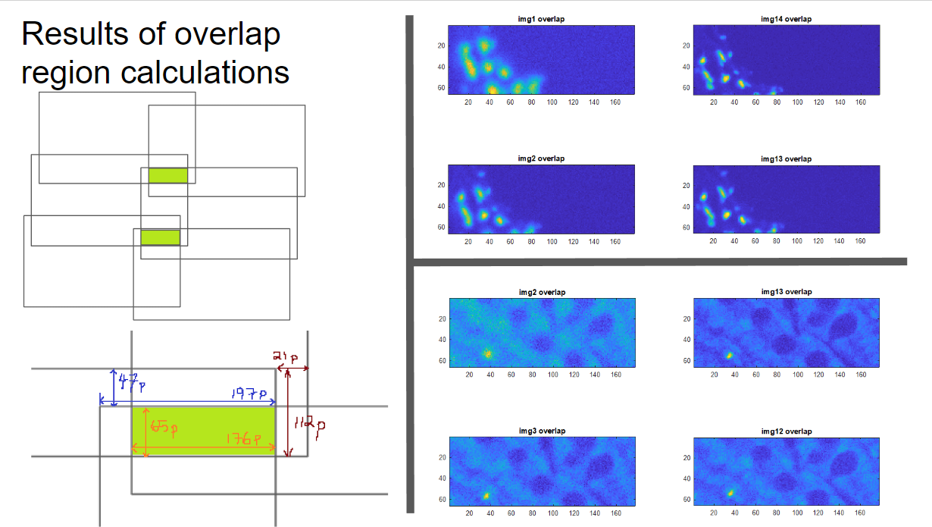

Slide 28


Camera Chip
Microscope
Sample

Slide 29
Camera Chip
Microscope
Sample

Slide 30
Camera Chip
Microscope
What if Stage and Chip are not parallel?
Sample

Slide 31
Camera Chip
Microscope
What if Stage and Chip are not parallel?
Sample

Slide 32
XY Repeatability
Stage translates beyond small displacements for tiling. It moves stage from under objective to under syringe for staining.
This vector is around an 80mm displacement in X and 5mm in Y.
X axis moved an AVG: 1.14 with std dev of 1.64 per cycle
Y axis moved an AVG: -.29 with a std dev of 0.49 per cycle
X is translated way way further than Y so its expected that it is less accurate.
Slide was taped to blackened dog tags for this experiment. The data pointed to this moving on the stage as it had a massive jump of 54 pixels in the Y from image 1 to 2. Its completely possible and likely that the actual stage accuracy is better than this as this is stage plus movement of slide on stage. Will repeat when get a drain chamber that firmly grasps slide to eliminate its movement.

Slide 33
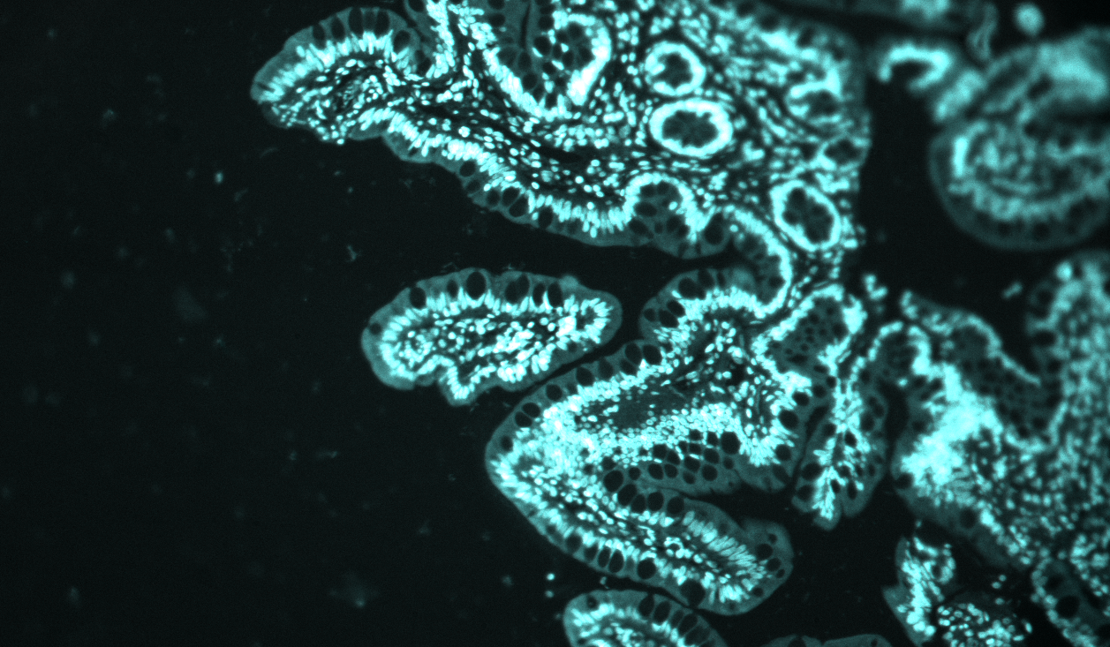
X and Y Repeatiblity
Here are the 3rd and 10th cycle images overlaid

Slide 34
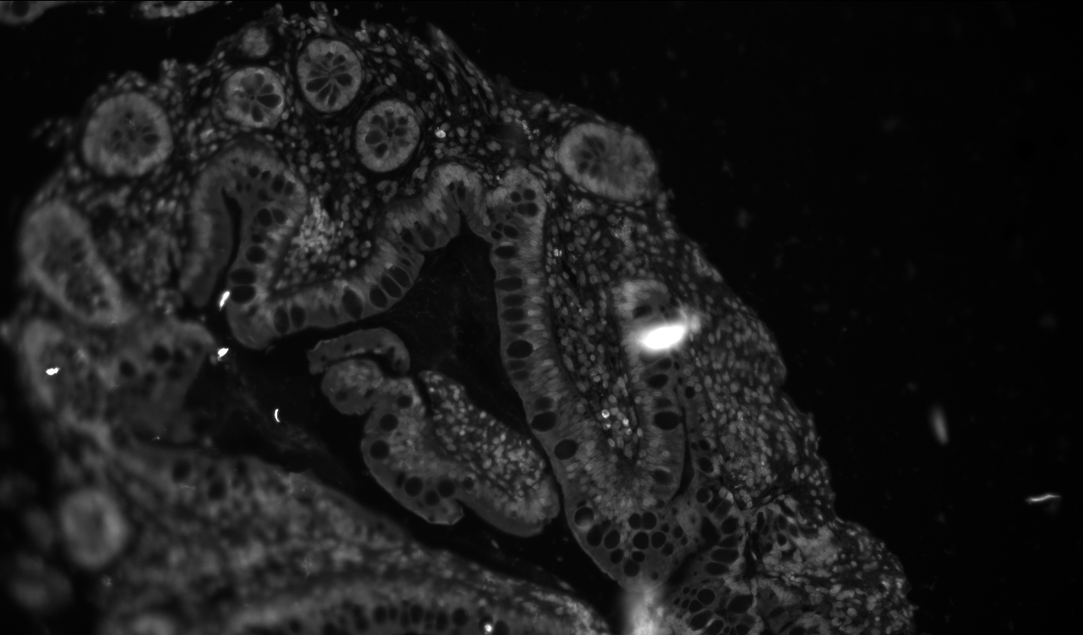
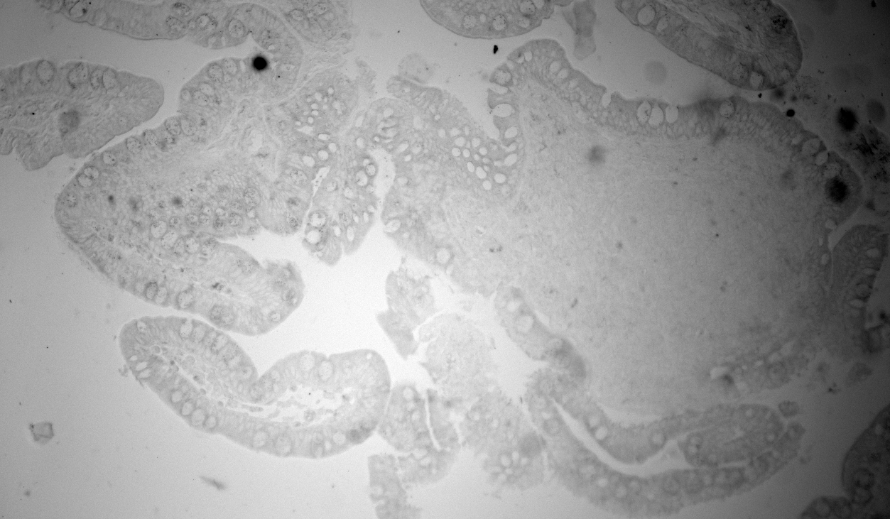
Reflection
Top: Image with blackened anodized Al dogtag behind slide. 1000ms exposure
Bottom: Image with 3D printed blue plastic housing behind slide. 2ms exposure
* Experimental Notes.
Top image was taken and then objective raised, Al dogtag was removed and slide reseated into plastic socket, objective lowered and reimaged.
No power cycles occurred. It was in the exact same state.

Slide 35
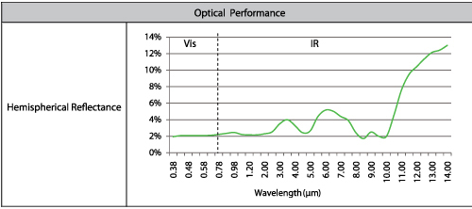
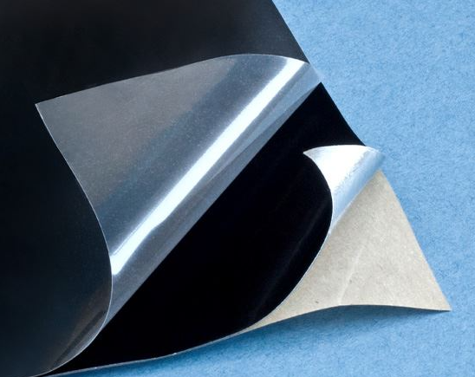
Ultimate Reflection Solution
Acktar’s Spectral Black Film
Market leader in maximal absorbing and low reflectance materials

Slide 36
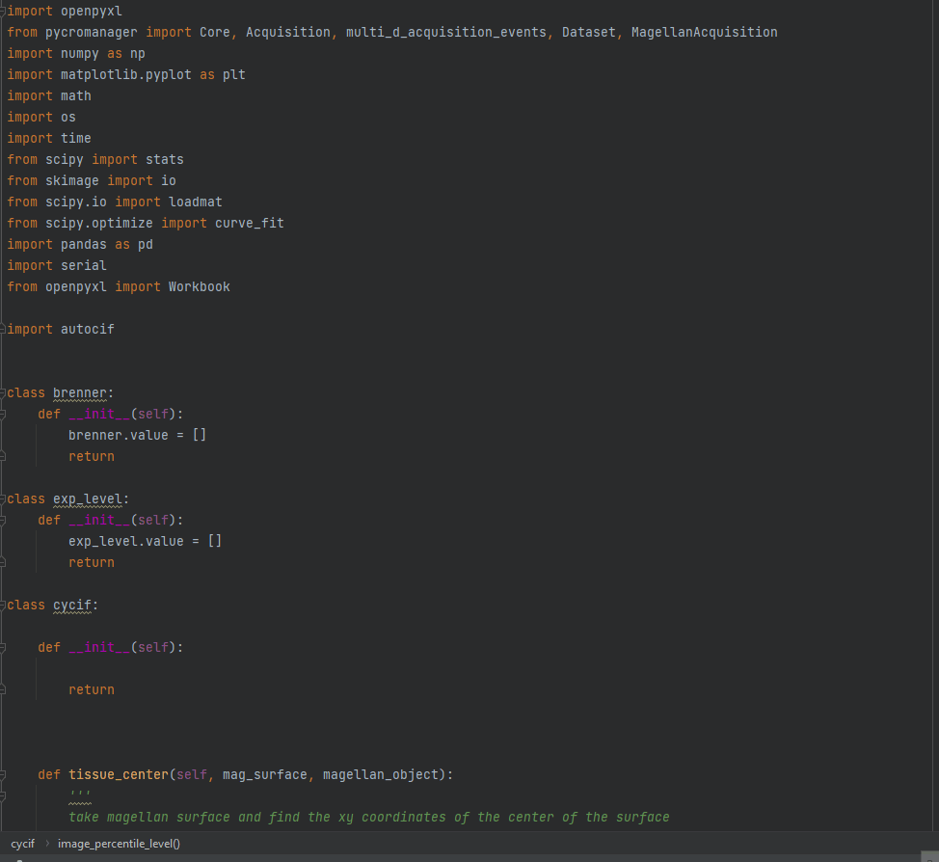

Slide 37
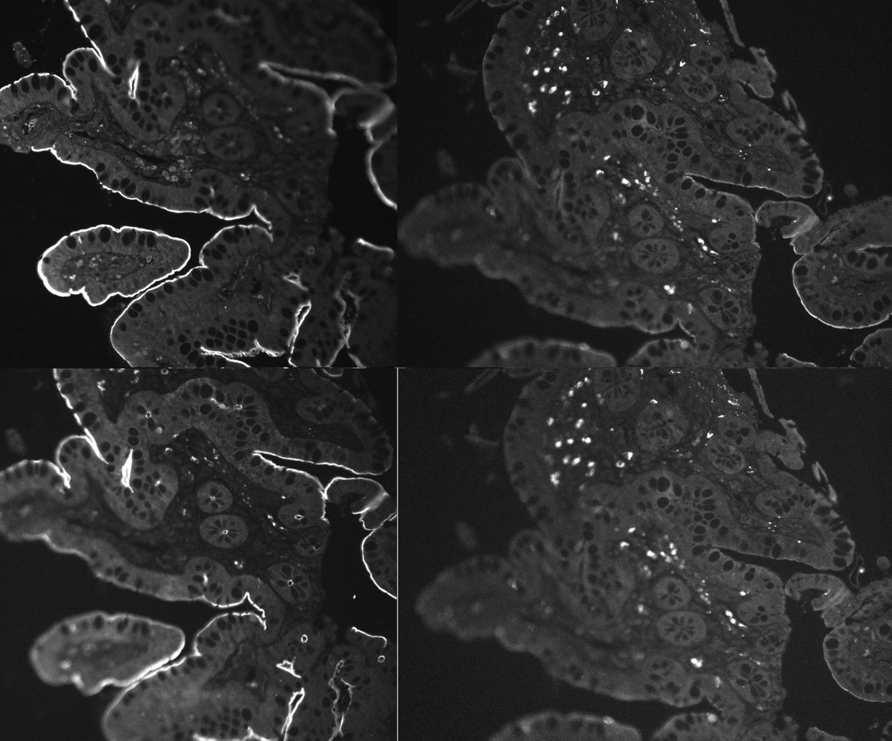
Bleaching Effectiveness
ECAD-488
ECAD-488 Bleached
Ezrin-488
Ezrin-488 Bleached

Slide 38
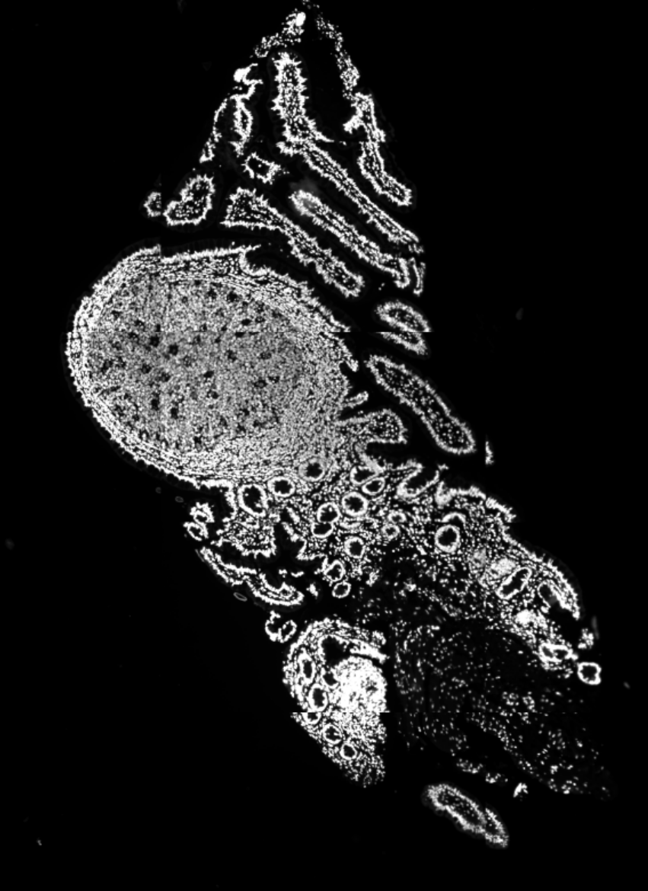




Cycle 1 DAPI
Cycle 1 MUC2
Cycle 1 Lysozyme A
Cycle 2 Ezrin
Cycle 2 Gamma Actin

Slide 39


Dye Kinetics
Goal = to optimize and document bleaching kinetics of CyCIF compatible dyes
Modulate known variables (pH and % H202)
Find relevant decay kinetics (half life)
Background
Expected decay kinetics form $e^{\frac{−t}{τ(pH, \% H2O2)}}+C$
Why are decays usually exponential? Decays happen due to per molecule occurrences. There is a % chance a molecule will be bleached per unit time. This chance is the same per molecule. Thus, the magnitude of change is proportional to the number of unbleached molecules remaining.
In other words: $Bleached rate=\frac{d molecules}{dt}=A∗molecules$-> $\int{molecules∗dt= e^{−A∗t}+C}=molecules$(solve ODE for this solution).

Slide 40


$$τ=\frac{1}{0.005}=210 seconds$$

Slide 41


$$τ=\frac{1}{0.006}=136 seconds$$

